Slide 1
Microsoft Visual C#: An Introduction to Object-Oriented Programming
7th Edition
Chapter 14
Files and Streams
© 2018 Cengage. All Rights Reserved. May not be copied, scanned, or duplicated, in whole or in part, except for use as permitted in a license distributed with a certain product or service or otherwise on a password-protected website for classroom use.

Slide 2
Objectives
14.1 Describe computer files and the File and Directory classes
14.2 Describe file data organization
14.3 Describe streams
14.4 Write to and read from a sequential access text file
14.5 Search a sequential access text file
14.6 Appreciate serialization and deserialization
© 2018 Cengage. May not be copied, scanned, or duplicated, in whole or in part, except for use as permitted in a license distributed with a certain product or service or otherwise on a password-protected website for classroom use.

Slide 3
Files and the File and Directory Classes (1 of 6)
Temporary storage
Usually called computer memory or random access memory (RAM)
Variables use temporary storage
Volatile
Permanent storage
Data is not lost when a computer loses power
Nonvolatile
The program is saved to a disk
© 2018 Cengage. May not be copied, scanned, or duplicated, in whole or in part, except for use as permitted in a license distributed with a certain product or service or otherwise on a password-protected website for classroom use.

Slide 4
Files and the File and Directory Classes (2 of 6)
Computer file
A collection of information stored on a nonvolatile device in a computer system
Files exist on permanent storage devices
Text files
Contain information in ASCII or Unicode characters
Can be data files or source code files (e.g., C# source code)
Binary files - Store software, images, music, etc.
Characteristics of a file
Occupies space on a section of a storage device
Has a name, a size, a type, and a specific time of creation
© 2018 Cengage. May not be copied, scanned, or duplicated, in whole or in part, except for use as permitted in a license distributed with a certain product or service or otherwise on a password-protected website for classroom use.

Slide 5
Files and the File and Directory Classes (3 of 6)
Byte
File sizes are measured in bytes
A byte is a small unit of storage
In a simple text file, a byte holds only one character
File sizes are usually expressed in:
Kilobytes = thousands of bytes
Megabytes = millions of bytes
Gigabytes = billions of bytes
© 2018 Cengage. May not be copied, scanned, or duplicated, in whole or in part, except for use as permitted in a license distributed with a certain product or service or otherwise on a password-protected website for classroom use.

Slide 6
Files and the File and Directory Classes (4 of 6)
Write to the file
Store data in a file on a persistent storage device
Read from the file
Copy data from a file on a storage device into RAM
Root Directory
The main storage location on your computer
© 2018 Cengage. May not be copied, scanned, or duplicated, in whole or in part, except for use as permitted in a license distributed with a certain product or service or otherwise on a password-protected website for classroom use.

Slide 7
Files and the File and Directory Classes (5 of 6)
Folder or Directory
A location inside the root directory designed to group items or files that are similar in nature
Path
A combination of the disk drive plus the complete hierarchy of directories in which a file resides
Example: C:\C#\Chapter.14\Data.txt
© 2018 Cengage. May not be copied, scanned, or duplicated, in whole or in part, except for use as permitted in a license distributed with a certain product or service or otherwise on a password-protected website for classroom use.

Slide 8
Files and the File and Directory Classes (6 of 6)
C# provides built-in classes named File and Directory
Contain methods to help you manipulate files and their directories
Access information about files
Create, delete, or move files
© 2018 Cengage. May not be copied, scanned, or duplicated, in whole or in part, except for use as permitted in a license distributed with a certain product or service or otherwise on a password-protected website for classroom use.

Slide 9
Using the File and Directory Classes (1 of 6)
File class
Contains methods to access information about files
Contained in the System.IO namespace
Directory class
Provides information about directories or folders
© 2018 Cengage. May not be copied, scanned, or duplicated, in whole or in part, except for use as permitted in a license distributed with a certain product or service or otherwise on a password-protected website for classroom use.

Slide 10
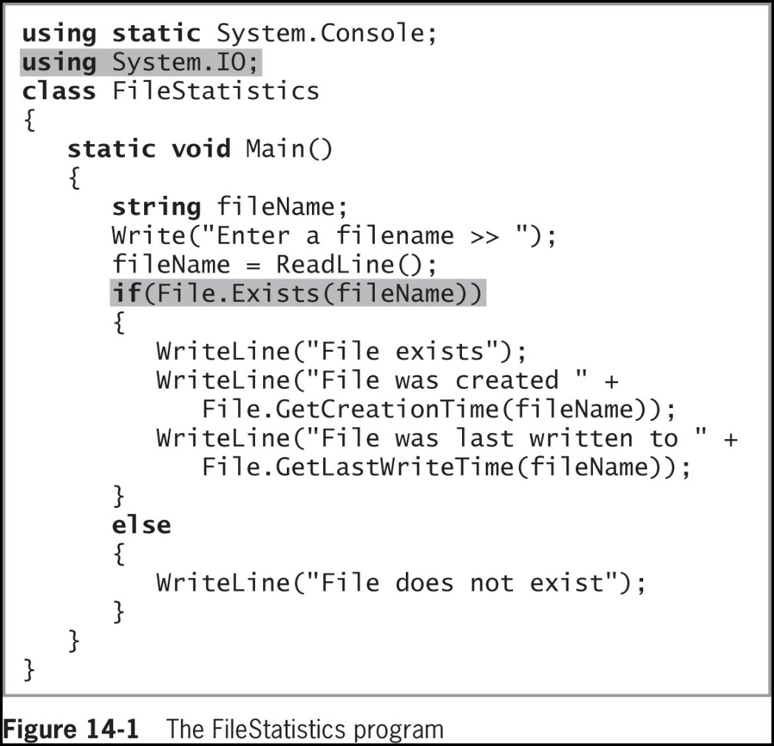
Using the File and Directory Classes (2 of 6)
© 2018 Cengage. May not be copied, scanned, or duplicated, in whole or in part, except for use as permitted in a license distributed with a certain product or service or otherwise on a password-protected website for classroom use.

Slide 11
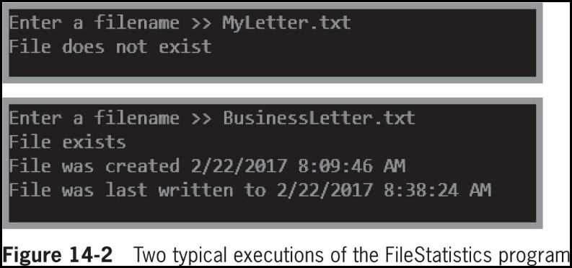
Using the File and Directory Classes (3 of 6)
© 2018 Cengage. May not be copied, scanned, or duplicated, in whole or in part, except for use as permitted in a license distributed with a certain product or service or otherwise on a password-protected website for classroom use.

Slide 12
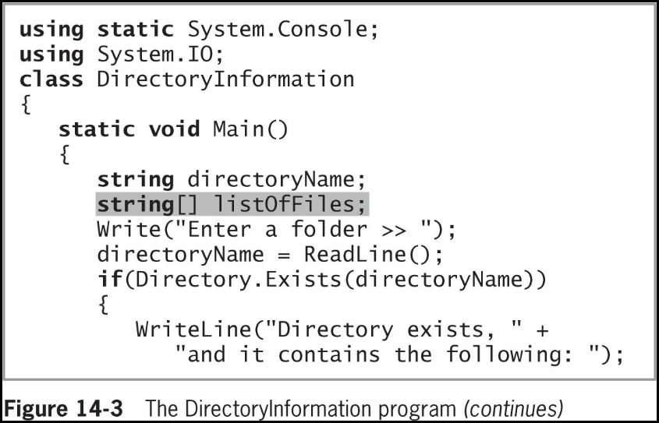
Using the File and Directory Classes (4 of 6)
Figure 14-3 contains a program that declares an array of strings where filenames can be stored
© 2018 Cengage. May not be copied, scanned, or duplicated, in whole or in part, except for use as permitted in a license distributed with a certain product or service or otherwise on a password-protected website for classroom use.

Slide 13
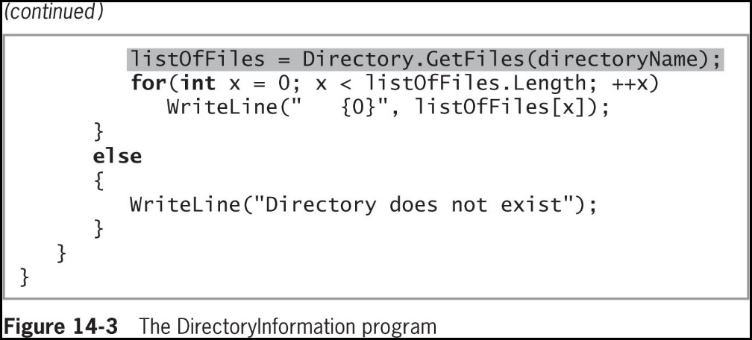
Using the File and Directory Classes (5 of 6)
© 2018 Cengage. May not be copied, scanned, or duplicated, in whole or in part, except for use as permitted in a license distributed with a certain product or service or otherwise on a password-protected website for classroom use.

Slide 14
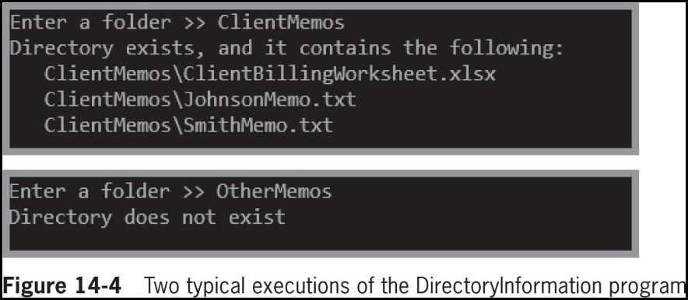
Using the File and Directory Classes (6 of 6)
© 2018 Cengage. May not be copied, scanned, or duplicated, in whole or in part, except for use as permitted in a license distributed with a certain product or service or otherwise on a password-protected website for classroom use.

Slide 15
Understanding File Data Organization (1 of 4)
Businesses store data in a relationship known as the data hierarchy
Character
Any of the letters, numbers, or other special symbols (such as punctuation marks) that comprise data
Characters are made up of bytes containing eight (8) bits
ASCII characters contain one (1) byte
Unicode characters contain two (2) bytes
© 2018 Cengage. May not be copied, scanned, or duplicated, in whole or in part, except for use as permitted in a license distributed with a certain product or service or otherwise on a password-protected website for classroom use.

Slide 16
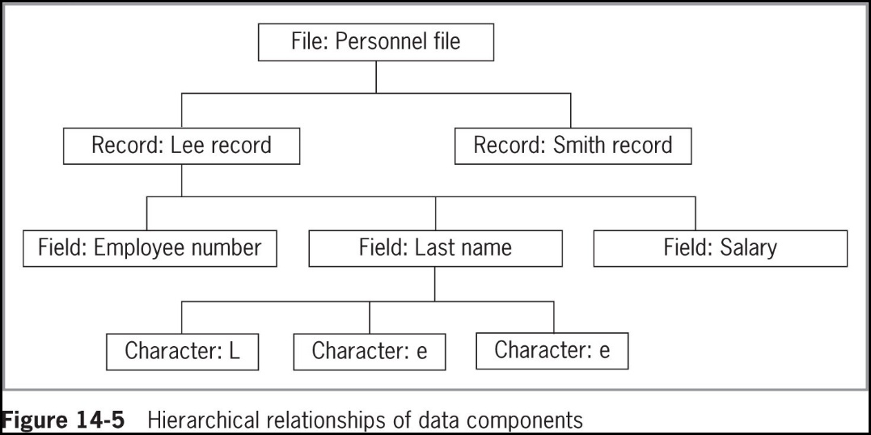
Understanding File Data Organization (2 of 4)
© 2018 Cengage. May not be copied, scanned, or duplicated, in whole or in part, except for use as permitted in a license distributed with a certain product or service or otherwise on a password-protected website for classroom use.

Slide 17
Understanding File Data Organization (3 of 4)
Field
A character or group of characters that has some meaning
Record
A collection of related fields that contain data about an entity
Sequential access file
Each record is read in order based on its relative position
Records can be stored in order based on a value in the record
The field used to uniquely identify each record in a sequential file is the key field
© 2018 Cengage. May not be copied, scanned, or duplicated, in whole or in part, except for use as permitted in a license distributed with a certain product or service or otherwise on a password-protected website for classroom use.

Slide 18
Understanding File Data Organization (4 of 4)
Random access file
Records are not in any sequence and can be accessed in any order
A C# application opens a file by creating an object and associating a stream of bytes with that object
When you finish using a file, the program should close the file
Not closing a file may make it inaccessible
Not closing an output file can result in data not being written to the file
© 2018 Cengage. May not be copied, scanned, or duplicated, in whole or in part, except for use as permitted in a license distributed with a certain product or service or otherwise on a password-protected website for classroom use.

Slide 19
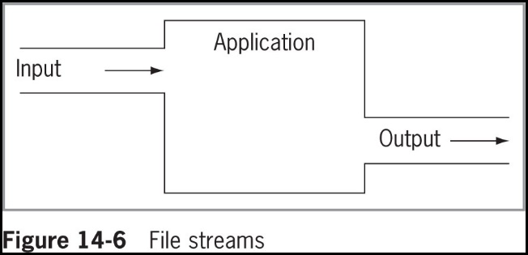
Understanding Streams (1 of 5)
Stream
Functions as a pipeline or channel between an input device and an application, and potentially an output device
© 2018 Cengage. May not be copied, scanned, or duplicated, in whole or in part, except for use as permitted in a license distributed with a certain product or service or otherwise on a password-protected website for classroom use.

Slide 20
Understanding Streams (2 of 5)
When you produce screen output and accept keyboard input, you use the Console class, which provides access to several standard streams:
Console.In
Standard input stream object - Accepts data from the keyboard
Console.Out
Standard output stream object - Allows a program to produce output on the screen
Console.Error
Standard error stream object - Allows a program to write error messages to the screen
© 2018 Cengage. May not be copied, scanned, or duplicated, in whole or in part, except for use as permitted in a license distributed with a certain product or service or otherwise on a password-protected website for classroom use.

Slide 21
Understanding Streams (3 of 5)
Most streams flow in only one direction
File processing classes include:
StreamReader for text input from a file
StreamWriter for text output to a file
FileStream is used alone for bytes and with either StreamReader and StreamWriter for text), for either input from and output to a file
© 2018 Cengage. May not be copied, scanned, or duplicated, in whole or in part, except for use as permitted in a license distributed with a certain product or service or otherwise on a password-protected website for classroom use.

Slide 22
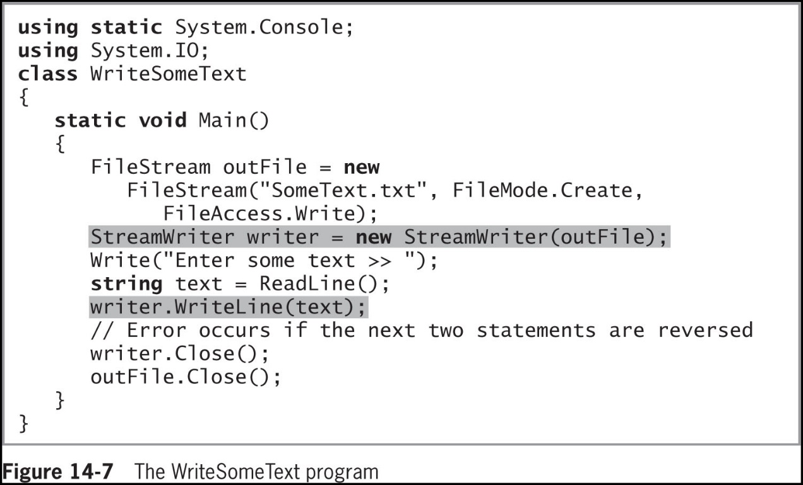
Understanding Streams (4 of 5)
Figure 14-7 shows an application in which a FileStream object named outFile is created, then associated with a StreamWriter named writer in the first shaded line
© 2018 Cengage. May not be copied, scanned, or duplicated, in whole or in part, except for use as permitted in a license distributed with a certain product or service or otherwise on a password-protected website for classroom use.

Slide 23
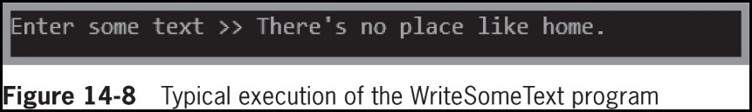
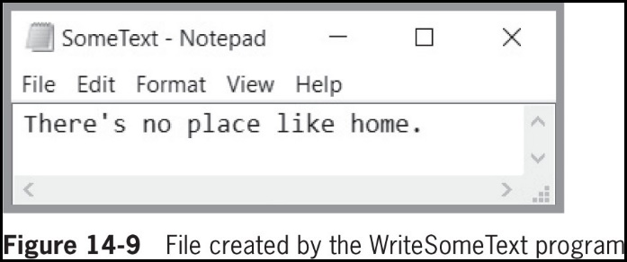
Understanding Streams (5 of 5)
© 2018 Cengage. May not be copied, scanned, or duplicated, in whole or in part, except for use as permitted in a license distributed with a certain product or service or otherwise on a password-protected website for classroom use.

Slide 24
Writing and Reading a Sequential Access File
C# uses files only as streams of bytes
When you write a program to store a data file, you must dictate the form the file will take
Whether you are writing data to a file or reading data from one, you create a FileStream object
© 2018 Cengage. May not be copied, scanned, or duplicated, in whole or in part, except for use as permitted in a license distributed with a certain product or service or otherwise on a password-protected website for classroom use.

Slide 25
Writing Data to a Sequential Access Text File (1 of 4)
Token
A block of text within a string that represents an entity or field
Delimiter
A character used to specify the boundary between records and, potentially, fields in text files
When you write data to a text file:
You can separate the fields with a delimiter
Delimiters are needed when fields are not fixed in size and position—field size varies
CSV files (comma-separated value files) are delimited files
© 2018 Cengage. May not be copied, scanned, or duplicated, in whole or in part, except for use as permitted in a license distributed with a certain product or service or otherwise on a password-protected website for classroom use.

Slide 26
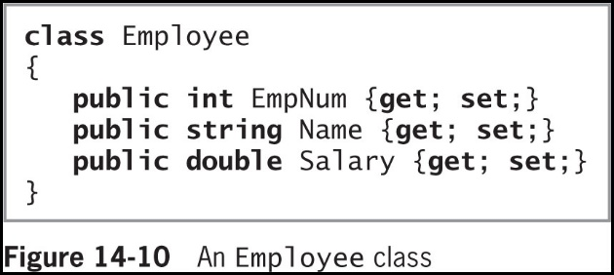
Writing Data to a Sequential Access Text File (2 of 4)
Figure 14-10 shows a typical Employee class that contains three fields and properties for each
© 2018 Cengage. May not be copied, scanned, or duplicated, in whole or in part, except for use as permitted in a license distributed with a certain product or service or otherwise on a password-protected website for classroom use.

Slide 27
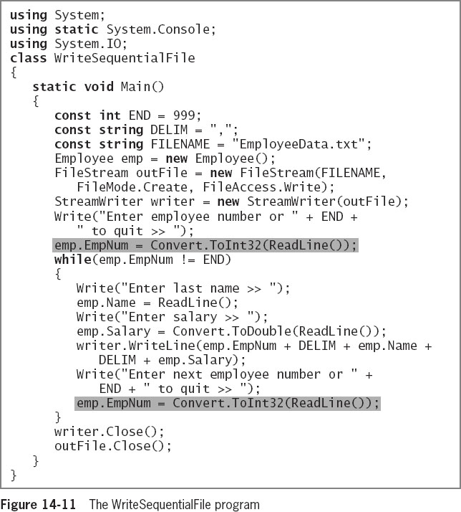
Writing Data to a Sequential Access Text File (3 of 4)
Figure 14-11 contains a complete program that opens a file and continuously prompts the user for Employee data
The first shaded statement is a priming read – an input statement that gets a first data item or record
© 2018 Cengage. May not be copied, scanned, or duplicated, in whole or in part, except for use as permitted in a license distributed with a certain product or service or otherwise on a password-protected website for classroom use.

Slide 28
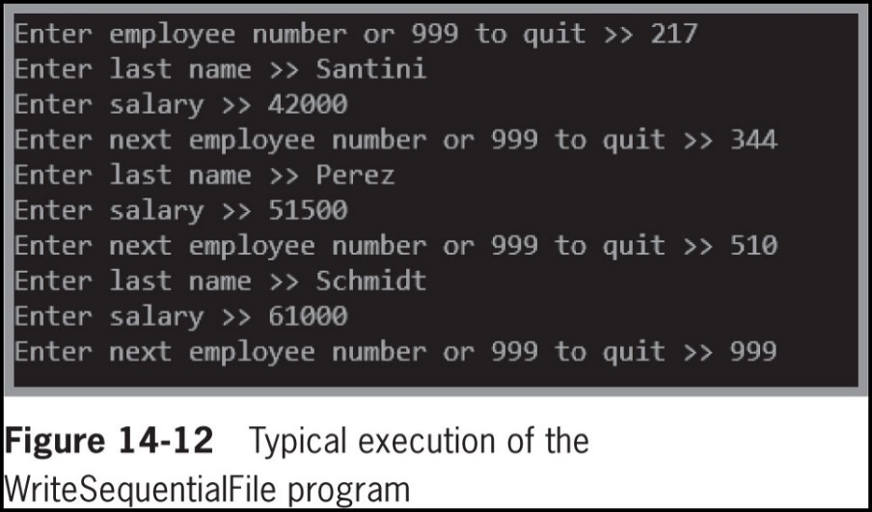
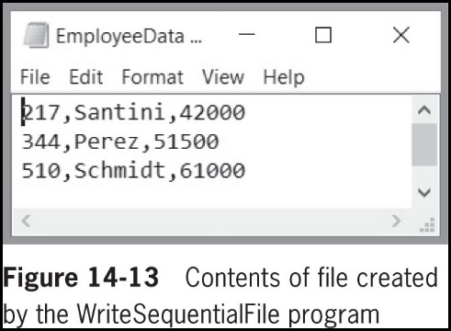
Writing Data to a Sequential Access Text File (4 of 4)
© 2018 Cengage. May not be copied, scanned, or duplicated, in whole or in part, except for use as permitted in a license distributed with a certain product or service or otherwise on a password-protected website for classroom use.

Slide 29
Reading from a Sequential Access Text File (1 of 3)
Reading from a text file is similar to writing to a text file
Classes used:
FileStream
StreamReader
FileStream inFile = new FileStream (FILENAME, FileMode.Open, FileAccess.Read);
StreamReader reader = new StreamReader (inFile);
© 2018 Cengage. May not be copied, scanned, or duplicated, in whole or in part, except for use as permitted in a license distributed with a certain product or service or otherwise on a password-protected website for classroom use.

Slide 30
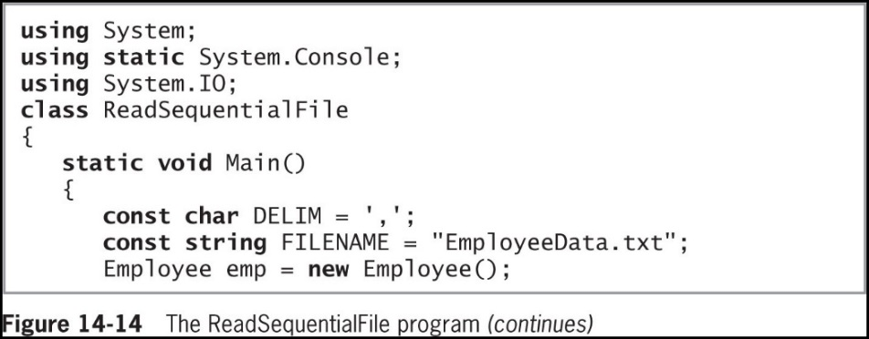
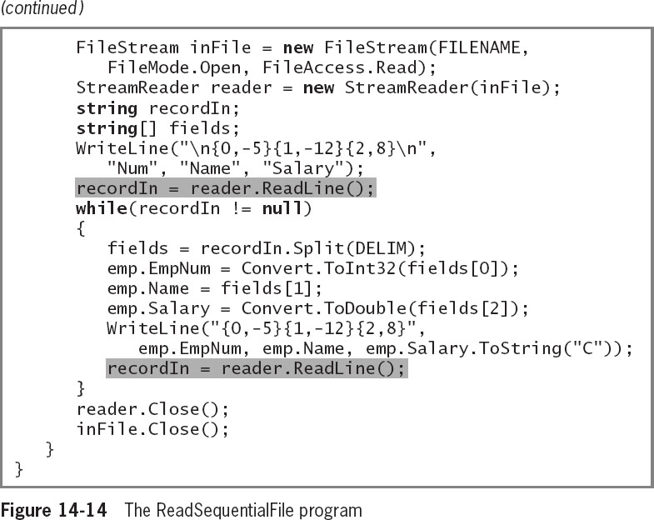
Reading from a Sequential Access Text File (2 of 3)
© 2018 Cengage. May not be copied, scanned, or duplicated, in whole or in part, except for use as permitted in a license distributed with a certain product or service or otherwise on a password-protected website for classroom use.

Slide 31
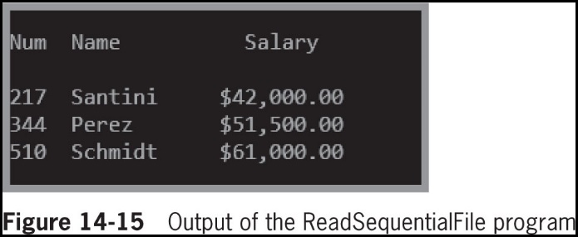
Reading from a Sequential Access Text File (3 of 3)
© 2018 Cengage. May not be copied, scanned, or duplicated, in whole or in part, except for use as permitted in a license distributed with a certain product or service or otherwise on a password-protected website for classroom use.

Slide 32
Searching a Sequential Text File (1 of 4)
File position pointer
Holds the byte number of the next byte to be read
Reposition the file pointer using the Seek() method and the SeekOrigin enumeration:
inFile.Seek(0, SeekOrigin.Begin);
© 2018 Cengage. May not be copied, scanned, or duplicated, in whole or in part, except for use as permitted in a license distributed with a certain product or service or otherwise on a password-protected website for classroom use.

Slide 33
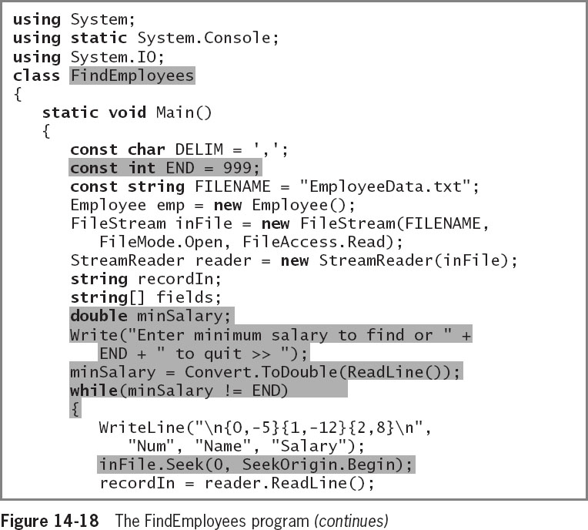
Searching a Sequential Text File (2 of 4)
Figure 14-18 contains a program that repeatedly searches a file to produce lists of employees who meet a minimum salary requirement
© 2018 Cengage. May not be copied, scanned, or duplicated, in whole or in part, except for use as permitted in a license distributed with a certain product or service or otherwise on a password-protected website for classroom use.

Slide 34
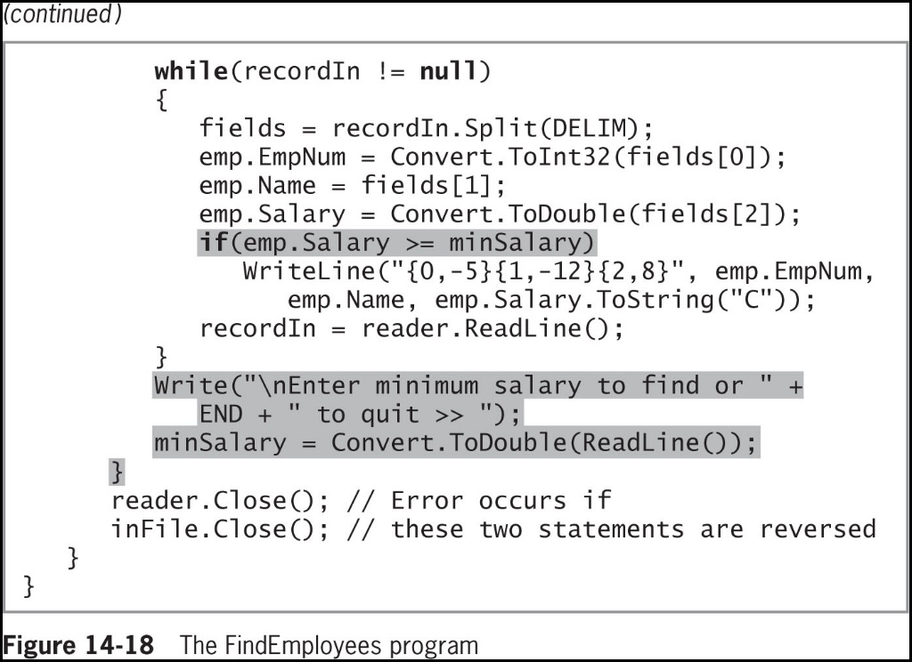
Searching a Sequential Text File (3 of 4)
© 2018 Cengage. May not be copied, scanned, or duplicated, in whole or in part, except for use as permitted in a license distributed with a certain product or service or otherwise on a password-protected website for classroom use.

Slide 35
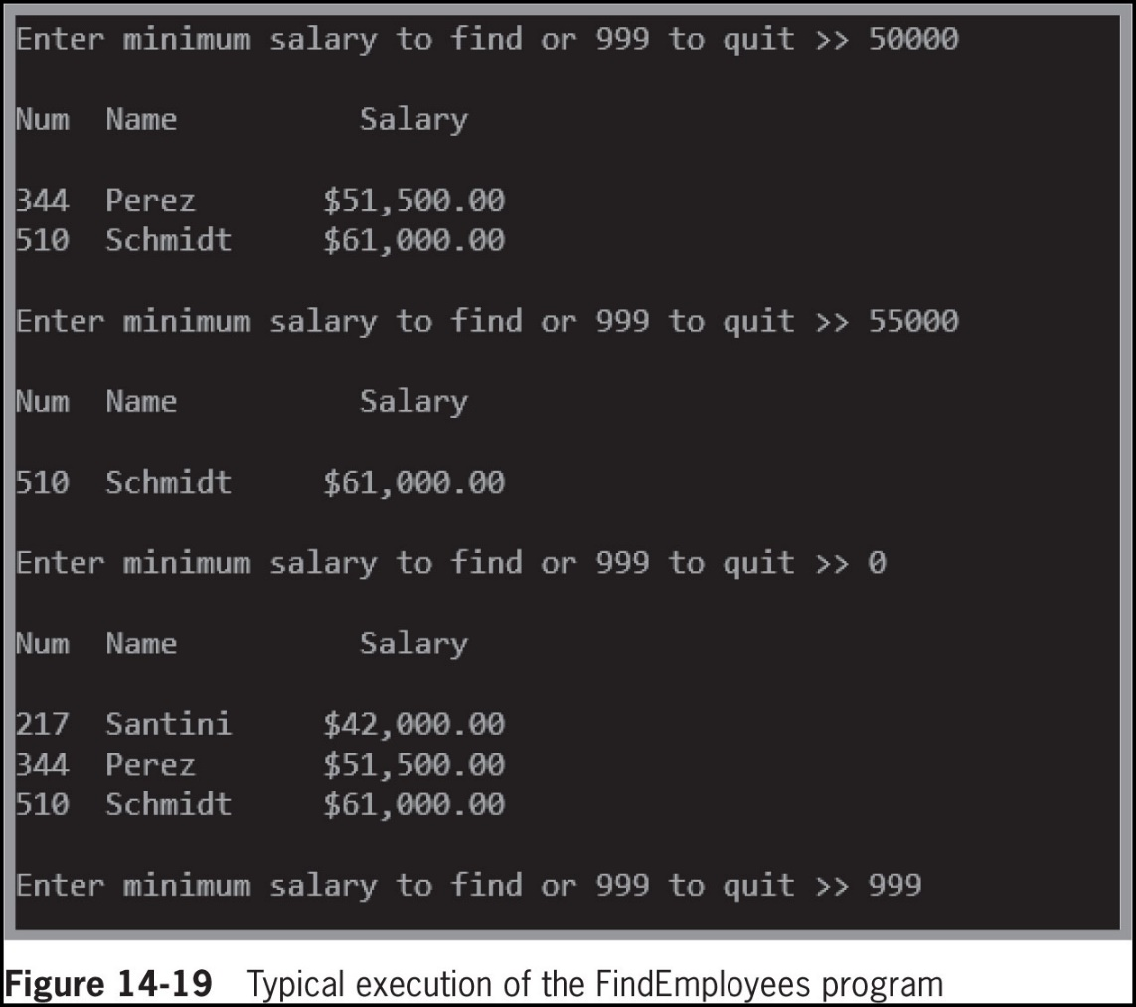
Searching a Sequential Text File (4 of 4)
© 2018 Cengage. May not be copied, scanned, or duplicated, in whole or in part, except for use as permitted in a license distributed with a certain product or service or otherwise on a password-protected website for classroom use.

Slide 36
Understanding Serialization and Deserialization (1 of 7)
Disadvantages to writing to a text file:
Data in a text file is easily readable in a text editor such as Notepad, which means it is not secure
It is cumbersome to convert each field to text and combine the fields with delimiters
You can write objects to and read objects from files
Serialization
The process of converting objects into streams of bytes
Deserialization
Converts streams of bytes back into objects
© 2018 Cengage. May not be copied, scanned, or duplicated, in whole or in part, except for use as permitted in a license distributed with a certain product or service or otherwise on a password-protected website for classroom use.

Slide 37
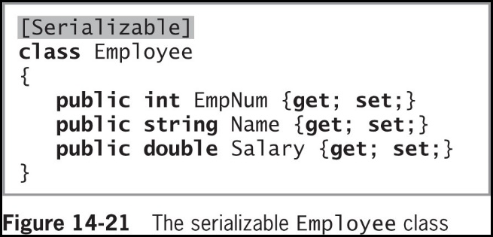
Understanding Serialization and Deserialization (2 of 7)
To create a class that can be serialized, you must mark it with the [Serializable] attribute
As shown in the shaded statement in Figure 14-21
© 2018 Cengage. May not be copied, scanned, or duplicated, in whole or in part, except for use as permitted in a license distributed with a certain product or service or otherwise on a password-protected website for classroom use.

Slide 38
Understanding Serialization and Deserialization (3 of 7)
In a class marked with the [Serializable] attribute, every instance variable must also be Serializable
By default, all C# simple data types are serializable, including strings
If your class contains fields that are more complex data types, you must check the declaration of those classes to ensure they are serializable
Namespaces included in programs that employ serialization:
System.Runtime.Serialization.Formatters.Binary;
System.Runtime.Serialization;
© 2018 Cengage. May not be copied, scanned, or duplicated, in whole or in part, except for use as permitted in a license distributed with a certain product or service or otherwise on a password-protected website for classroom use.

Slide 39
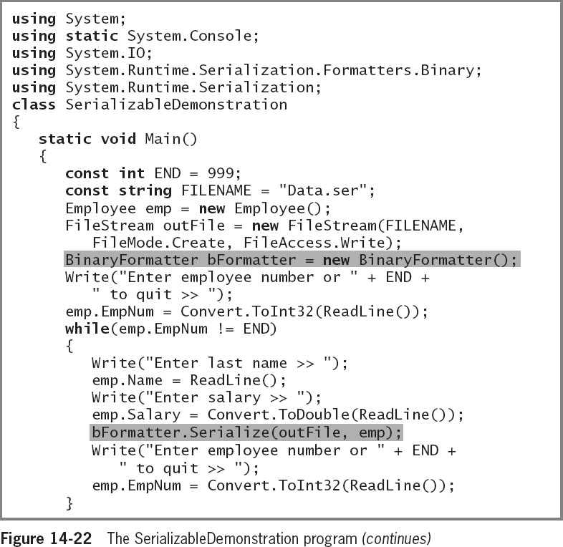
Understanding Serialization and Deserialization (4 of 7)
Figure 14-22 shows a program that writes Employee class objects to a file and later reads them from the file into the program
© 2018 Cengage. May not be copied, scanned, or duplicated, in whole or in part, except for use as permitted in a license distributed with a certain product or service or otherwise on a password-protected website for classroom use.

Slide 40
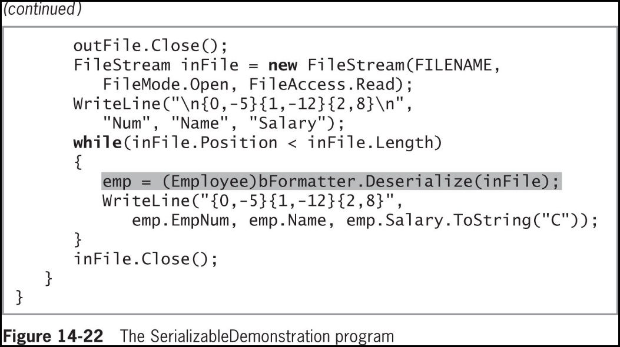
Understanding Serialization and Deserialization (5 of 7)
© 2018 Cengage. May not be copied, scanned, or duplicated, in whole or in part, except for use as permitted in a license distributed with a certain product or service or otherwise on a password-protected website for classroom use.

Slide 41
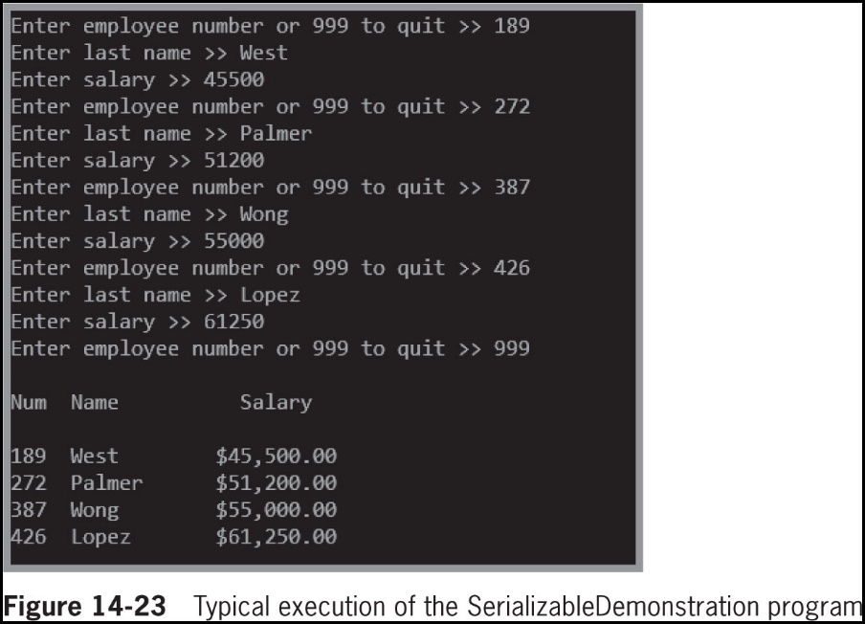
Understanding Serialization and Deserialization (6 of 7)
© 2018 Cengage. May not be copied, scanned, or duplicated, in whole or in part, except for use as permitted in a license distributed with a certain product or service or otherwise on a password-protected website for classroom use.

Slide 42
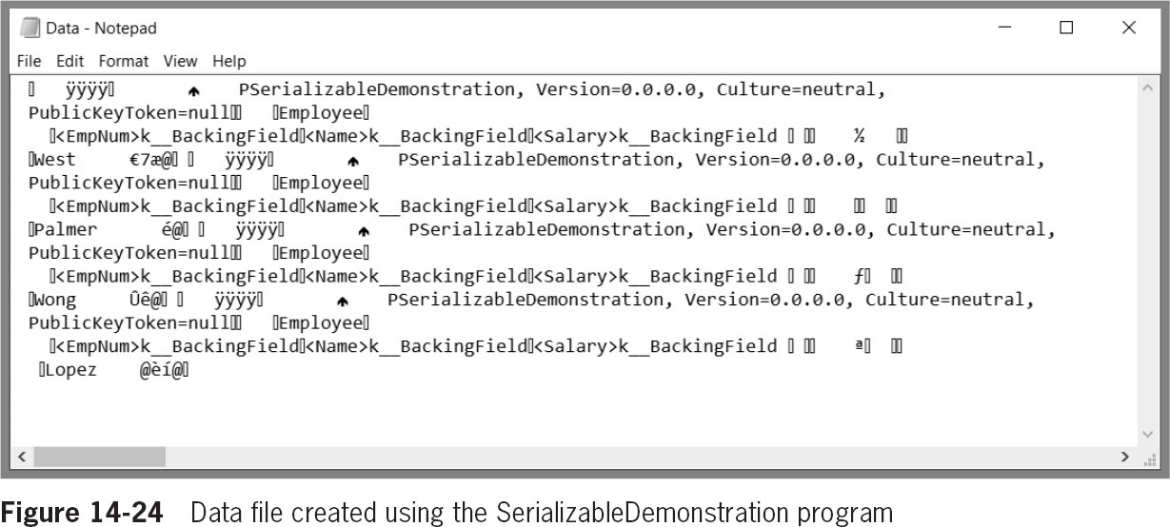
Understanding Serialization and Deserialization (7 of 7)
© 2018 Cengage. May not be copied, scanned, or duplicated, in whole or in part, except for use as permitted in a license distributed with a certain product or service or otherwise on a password-protected website for classroom use.

Slide 43
Chapter Summary (1 of 2)
A computer file is a collection of information stored on a nonvolatile, permanent storage device in a computer system
The File class contains methods that allow you to access information about files
The Directory class provides you with information about directories or folders
Data items are stored in a hierarchy of character, field, record, and file
A data file is a sequential access file when each record is read in order from first to last
Bytes flow into and out of applications through streams
© 2018 Cengage. May not be copied, scanned, or duplicated, in whole or in part, except for use as permitted in a license distributed with a certain product or service or otherwise on a password-protected website for classroom use.

Slide 44
Chapter Summary (2 of 2)
Data can be written to a StreamWriter object using the WriteLine() method
Data can be read from a StreamReader object using the ReadLine() method
When you read data from a sequential file, subsequent records are read in order
Serialization converts objects into streams of bytes
Deserialization converts streams of bytes back into objects
© 2018 Cengage. May not be copied, scanned, or duplicated, in whole or in part, except for use as permitted in a license distributed with a certain product or service or otherwise on a password-protected website for classroom use.

